Slide 1


Slide 2
Agenda
Presentation
Bioinformatics pipelines challenges
Nextflow as a solution
Key concepts
Execution environment
Conclusions
Demo
One-step pipeline
Two-step pipeline
Real bioinformatics pipeline
Local only
Data in the cloud
Running tasks in the cloud

Slide 3
Common Challenges
My script broke at step 3... now what?
It ran fine on my laptop, but ...
Running 100,000 samples is a headache
...
Notes:
Block1 - intro
-get rid out quotes

Slide 4
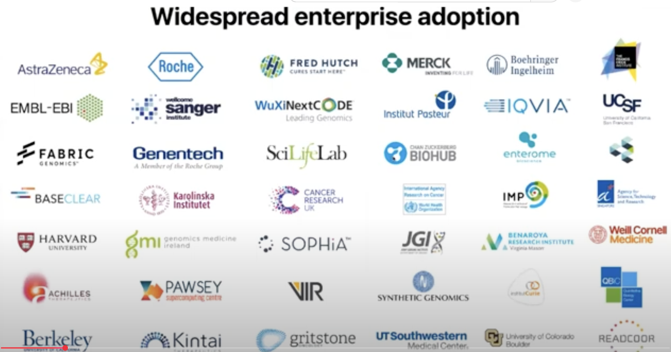
used by over 1,000 organizations, including some of the world’s largest pharmaceutical firms.
Notes:
Block1 - intro
Marketing slide : With Michael
https://workflows.community/stories/2022/09/28/nextflow/
-this technology was created more than a decade ago(2013) —>> today there is a huge community of research scientists and bioinformaticians from both industry and academia developing their pipelines using nextflow
nf-core is a community-driven project that collects a curated set of best-practice bioinformatics pipelines built using the Nextflow workflow manager.
-the community process this project nf-core in 2018, and currently there are () many pipelines and () many bioinformatic modules
What is Nextflow
Closing statement : It is also important the —--- community developed best practices on how to implement multistep bioinformatic pipelines - that is why this framework is so well adopted
People should start loving Nextflow immediately
Statistics
Logos of the companies
Explain Nextflow as a workflow orchestrator that solves these problems. Use a simple metaphor, such as Nextflow being the "conductor" for your data pipeline.
MAIN BENEFITS: -speed development
- decompose logic of bioinformatic pipeline from the deployment and execution environment definition
https://workflows.community/stories/2022/09/28/nextflow/

Slide 5

Nf-core is a community-driven project
There are 139 pipelines
There are 1634 modules
And there are 87 sub workflows
https://nf-co.re/
Notes:
Nextflow - created in 2013
They have worked out best practices for designing and implementing bioinformatic pipelines
that collects a curated set of best-practice bioinformatics pipelines
Block1 - intro
Marketing slide : With Michael
https://workflows.community/stories/2022/09/28/nextflow/
-this technology was created more than a decade ago(2013) —>> today there is a huge community of research scientists and bioinformaticians from both industry and academia developing their pipelines using nextflow
nf-core is a community-driven project that collects a curated set of best-practice bioinformatics pipelines built using the Nextflow workflow manager.
-the community process this project nf-core in 2018, and currently there are () many pipelines and () many bioinformatic modules
What is Nextflow
Closing statement : It is also important the —--- community developed best practices on how to implement multistep bioinformatic pipelines - that is why this framework is so well adopted
People should start loving Nextflow immediately
Statistics
Logos of the companies
Explain Nextflow as a workflow orchestrator that solves these problems. Use a simple metaphor, such as Nextflow being the "conductor" for your data pipeline.
MAIN BENEFITS: -speed development
- decompose logic of bioinformatic pipeline from the deployment and execution environment definition
https://workflows.community/stories/2022/09/28/nextflow/

Slide 6
Key Concepts: Process, Channel, Workflow
FILE
Channel 1
Channel 2
Process A
Process C
Process A
Process B
Process B
Channel 3
FILE
Process D
Process E
Notes:
Block1 - intro
Define concepts
Process is…. E.g. bioinformatics tool, unix command, custom code
Channel (with data objects inside channels) is …
Workflow - overall schema
Sub workflow - modularity of Nextflow
Nextflow controls data flow…

Slide 7
Pipeline Execution
Execution Environment
Task 1:
Bioinformatic Pipeline
z
Input File
Task 2:
...
Process input data
y
x
y
z
Channel with input data
Task 3:
x
...
Local , Cloud (AWS/Azure/GCP)
Notes:
Block1 - intro
1.Define Tasks: When the channel pushed through the data to the process, the process creates a separate task for the data
2. Speed development: Bioinformaticians should focus only on the pipeline design (left pane), and Nextflow will take care about the execution
3. Scale up: Nextflow will run tasks in parallel
4. Control: based on available resources
5. Execution environment: can be local machine or cloud

Slide 8
One-step pipeline
Process
Download protein sequence from NCBI
Channel
NP_001186746
NP_001186747
NP_001186748
Notes:
Block2 - Simple pipeline
Goal: combine all concepts together

Slide 9
One-step pipeline: Demo
Notes:
Description of the code
Observability:
see what is the output and the success of the process, and see the work directory created
nextflow run slide_simple_pipeline.nf -ansi-log false
Parallel execution: there is no for loop nextflow does it in parallel
Show export data: publishDir 'protein_sequence', mode: 'copy'

Slide 10
Two-step pipeline
Process 1
NP_001186746
NP_001186747
NP_001186748
NP_001186749
NP_001186749
…
Channel
Download protein sequence from NCBI
Process 2
Channel with fasta files
NP_001186746, 125
NP_001186747, 245
NP_001186748, 456
NP_001186749, 4534
NP_001186749, 3453
…
Calculate sequence length
Notes:
Block2 - Simple pipeline
Goal: combine all concepts together

Slide 11
Two-step pipeline: Demo

Slide 12
Real Bioinformatics pipeline

Slide 13
Bioinformatics Pipeline
https://github.com/nextflow-io/training.git
Fasta file
Process INDEX
index_ch
Process QUANTIFICATION
Process A
read_pairs_ch
Process MULTIQC
Mixed Channel
Fastq File
Fastq File
Process FASTQC
read_pairs_ch

Slide 14
Local Only
Data in the Cloud
Run Tasks in the Cloud
Cloud Only
work
work
T
T
T
Results
Cloud
Nextflow process
T
T
T
Results
Input
Results
work
work
T
T
T
T
T
T
Nextflow process
Nextflow process
Nextflow process
Local
Input
Input
Input
Results

Slide 15
Local Only
Data in the Cloud
Run Tasks in the Cloud
Cloud Only
work
results
work
results
Cloud
results
T
T
T
Nextflow process
T
T
T
input
work
results
work
Nextflow process
Local
T
T
T
T
T
T
input
Nextflow process
Nextflow process
input
input

Slide 16
Local Only
Data in the Cloud
Run Tasks in the Cloud
Cloud Only
work
results
work
results
Cloud
results
T
T
T
Nextflow process
T
T
T
input
work
results
work
Nextflow process
Local
T
T
T
T
T
T
input
Nextflow process
Nextflow process
input
input

Slide 17
Local Only
Data in the Cloud
Run Tasks in the Cloud
Cloud Only
work
results
work
results
Cloud
results
T
T
T
Nextflow process
T
T
T
input
work
results
work
Nextflow process
Local
T
T
T
T
T
T
input
Nextflow process
Nextflow process
input
input

Slide 18
Local Only
Data in the Cloud
Run Tasks in the Cloud
Cloud Only
work
results
work
results
Cloud
results
T
T
T
Nextflow process
T
T
T
input
work
results
work
Nextflow process
Local
T
T
T
T
T
T
input
Nextflow process
Nextflow process
input
input

Slide 19
Demo

Slide 20
Local Only
Data in the Cloud
Run Tasks in the Cloud
Cloud Only
work
results
work
results
Cloud
results
T
T
T
Nextflow process
T
T
T
input
work
results
work
Nextflow process
Local
T
T
T
T
T
T
input
Nextflow process
Nextflow process
input
input

Slide 21
Local Only
Data in the Cloud
Run Tasks in the Cloud
Cloud Only
work
results
work
results
Cloud
results
T
T
T
Nextflow process
T
T
T
input
work
results
work
Nextflow process
Local
T
T
T
T
T
T
input
Nextflow process
Nextflow process
input
input

Slide 22
Local Only
Data in the Cloud
Run Tasks in the Cloud
Cloud Only
work
results
work
results
Cloud
results
T
T
T
Nextflow process
T
T
T
input
work
results
work
Nextflow process
Local
T
T
T
T
T
T
input
Nextflow process
Nextflow process
input
input

Slide 23
AWS Batch
Compute Environment
Job
Queue
Job
Definition
Job
Definition
Nextflow

Slide 24
Local Only
Data in the Cloud
Run Tasks in the Cloud
Cloud Only
work
results
work
results
Cloud
results
T
T
T
Nextflow process
T
T
T
input
work
results
work
Nextflow process
Local
T
T
T
T
T
T
input
Nextflow process
Nextflow process
input
input

Slide 25
Cloud Only
Amazon S3
AWS Batch
Input data, Work, Results
T1
Head Node
T2
T3

Slide 26
Conclusion
Portability and Scalability
Abstracts the execution environment
Built-in parallelization
Flexible scaling
Reproducibility
Containerization support
Version management with Git
Strong community standards
Robustness and efficiency
Automatic checkpointing
Stream-oriented design
Simplified development
Notes:
Nextflow is a scientific workflow management system that makes creating and deploying complex computational pipelines easier, especially for data-intensive research like bioinformatics. Its key benefits center on reproducibility, scalability, and portability across different computing environments, allowing scientists to focus on the research rather than the underlying infrastructure.
Portability and scalability
Abstracts the execution environment: Nextflow provides a layer of abstraction that separates the pipeline logic from the execution environment. This means a pipeline can run on a local machine, an on-premise high-performance computing (HPC) cluster, or major cloud platforms like AWS and Google Cloud by simply changing a configuration file.
Built-in parallelization: Nextflow uses a dataflow programming model, where tasks are executed in parallel as soon as their input data is available. This approach greatly simplifies running complex, distributed tasks and allows them to automatically scale up or out depending on the computing resources.
Flexible scaling: As datasets grow, Nextflow pipelines can be seamlessly scaled to handle the increased load, from a small-scale test to a large-scale production run across hundreds of nodes.
Reproducibility
Containerization support: Nextflow integrates with container technologies such as Docker and Singularity, packaging the code and all its dependencies into isolated, reproducible environments. This ensures that the pipeline produces the same results regardless of where it is run, which is crucial for scientific validation.
Version management with Git: Integration with Git allows for version control of pipelines, ensuring that the exact code and configuration used for any given analysis can be retrieved and reused.
Strong community standards: The nf-core community develops and maintains a vast, high-quality collection of best-practice Nextflow pipelines for various bioinformatics applications. These pipelines are extensively documented, peer-reviewed, and rigorously tested for maximum reliability and reproducibility.
Robustness and efficiency
Automatic checkpointing: Nextflow automatically saves the intermediate results of a pipeline. If a workflow fails, you can restart it from the last successful checkpoint with the -resume flag, saving significant time and computational costs.
Stream-oriented design: The use of channels, or asynchronous data queues, for communication between processes simplifies the handling of complex data flows. It allows developers to focus on the functional steps of the analysis rather than managing dependencies.
Simplified development: Nextflow's domain-specific language (DSL) is concise and expressive, built on top of the Groovy programming language. It simplifies the orchestration of multiple tasks and allows users to incorporate scripts written in languages like Bash, Python, and R.
Collaboration and community
Easy sharing: Because Nextflow workflows can be hosted on Git repositories, they can be easily shared and pulled by others. This fosters collaboration and allows teams to build upon existing, well-tested pipelines.
Large, active ecosystem: The Nextflow community, including the nf-core initiative, provides extensive training materials, pre-built pipelines, and peer support. This ecosystem accelerates development and ensures that pipelines stay up-to-date with best practices.

Slide 27
Thank you!

